Slide 1
Predicting exoplanet status using
How Company Name increased sales by XX%

Slide 2
The Problem
Data
Issue
Problem statement
The data set measures Flux values of 5087 stars. These measurements are taken roughly every 30 minutes, and consist of 3198 measurements.
https://www.kaggle.com/keplersmachines/kepler-labelled-time-series-data
The measurement of this data is both time and data intensive
Will prediction of exoplanet status be lessened using varying/shortened measuring timescales?

Slide 3
SMOTE (Synthetic Minority Oversampling TEchnique)
Challenge
Solution
Result
Imbalanced Data
Label 1: 5050
Label 2: 37
With data this unbalanced, any prediction will be inaccurate
SMOTE
Creating random, synthetic rows of the minority label using a nearest neighbor algorithm.
K-nearest neighbors model
Our now resampled data can be fed into a random forest classifier to find precision and recall

Slide 4
SMOTE (Synthetic Minority Oversampling TEchnique)
sm = SMOTE(random_state=1,sampling_strategy=0.8)
x_train,y_train = sm.fit_sample(x_train,y_train)
x_test,y_test = sm.fit_sample(x_test,y_test)

Slide 5
Why RandomForestClassifier?
LinearSVC
Could not run; kernel consistently died in spite of parameters
KNearestNeighbor
Best Result: n_neighbors=19
Recall = [0.9522792 0.54545455]
RandomForestClassifier
Best Result: n_estimators=3, min_impurity_decrease=0.0000001, max_leaf_nodes = 6
Recall = [0.88817664 0.72727273]

Slide 6
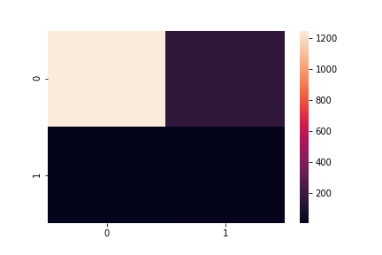
Confusion Matrix & Heatmap
[1247, 157],
[ 3, 8]

Slide 7
Recall
No Exoplanet (1)
Exoplanet (2)
text
88.8%
72.7%

Slide 8
Longer Time Between Measurements

Slide 9
Time Between Measurements- 2 Parts
ith_Column
Removing consecutive columns, keeping only every ith_column
Shift
Shifts the starting column by shift
For example a table with ith_col = 3 and shift = 1 will keep column 2,5,8 etc.

Slide 10
Observations

Slide 11
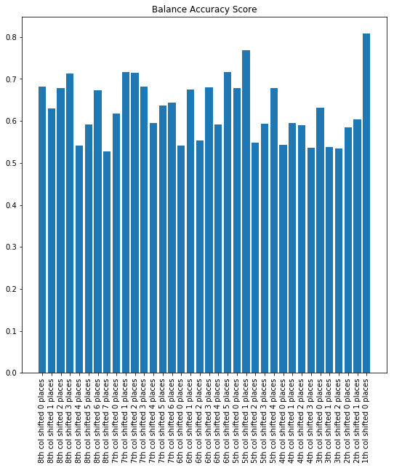
Time Between Measurements: 8

Slide 12
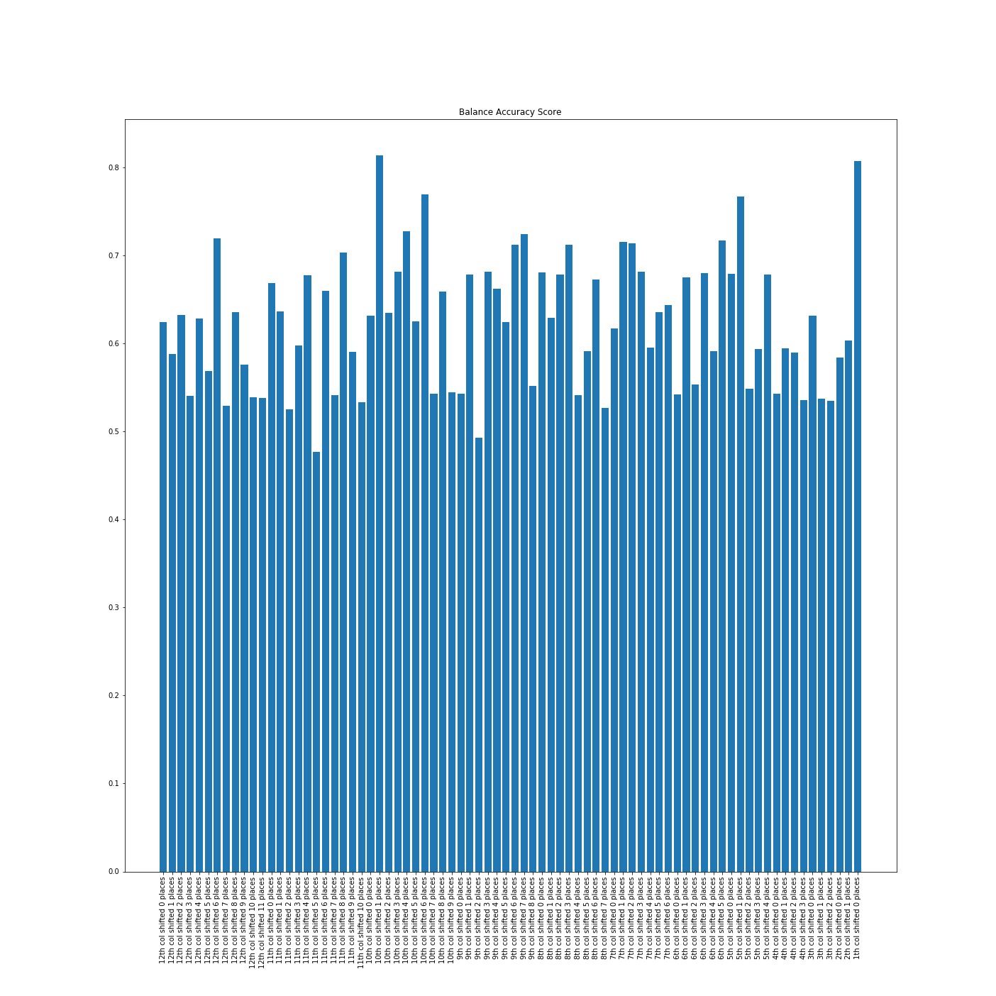
Time Between Measurements: 12

Slide 13
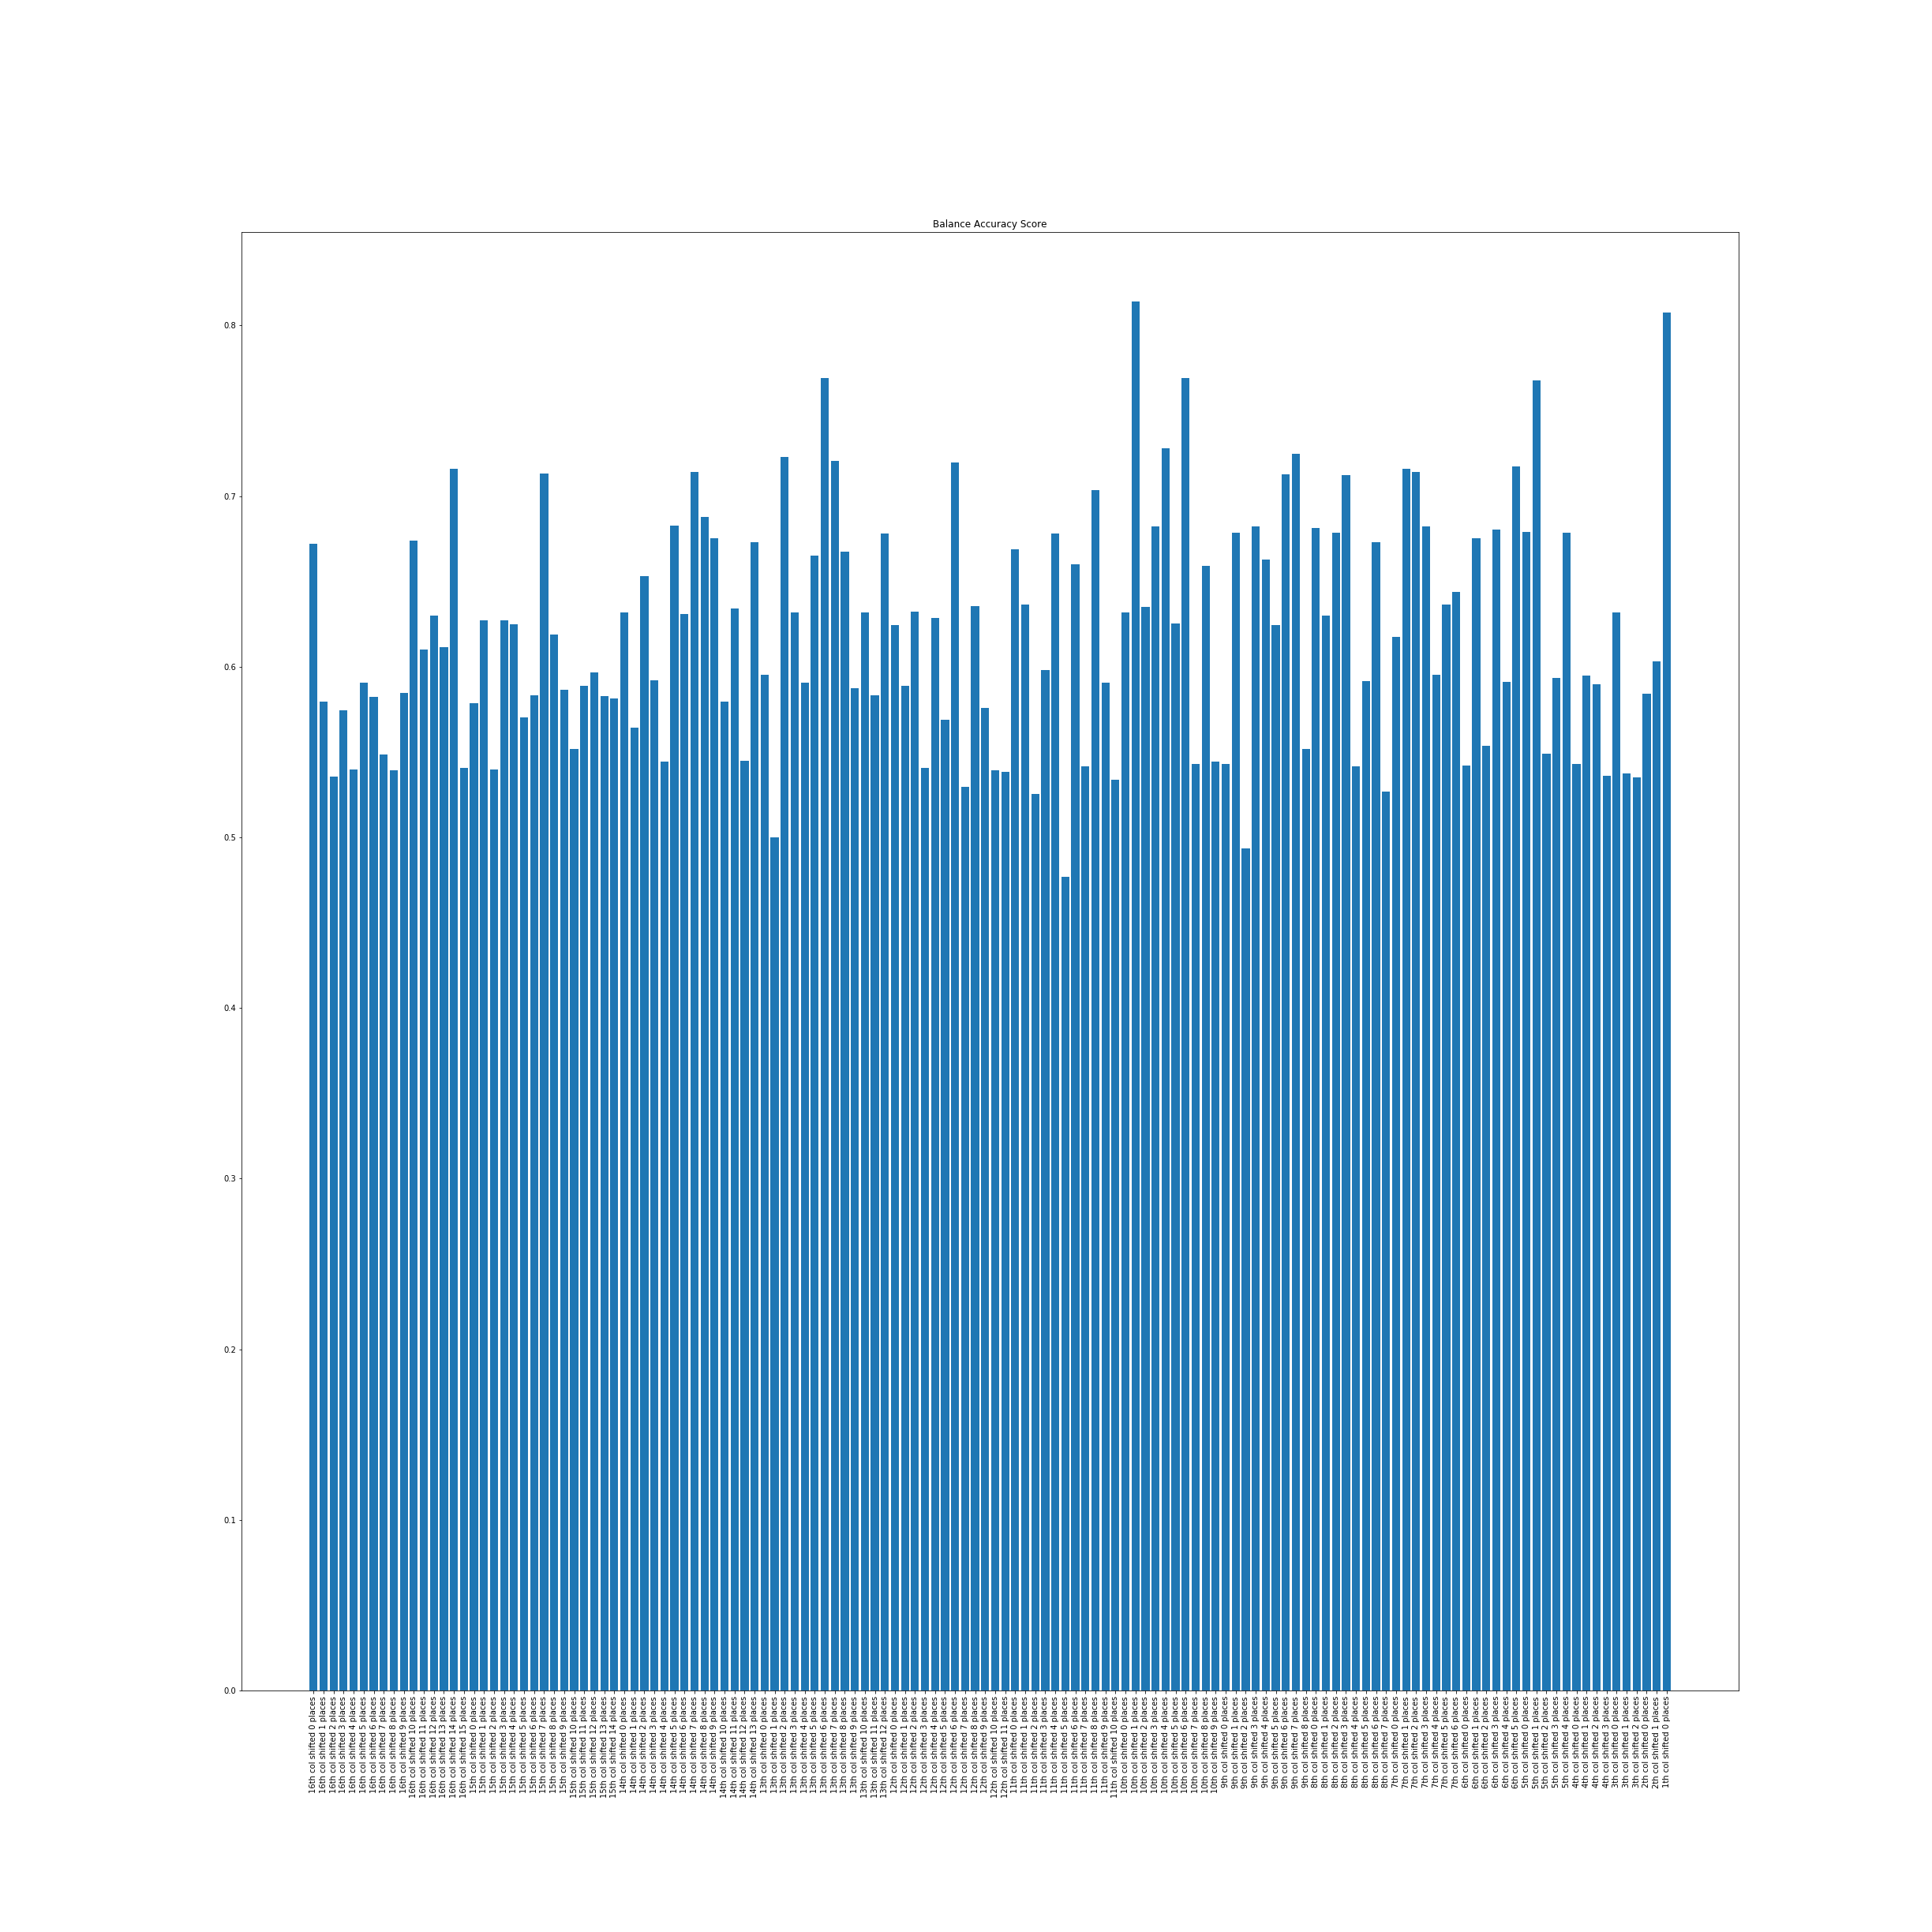
Time Between Measurements: 16

Slide 14
Observation Cont.
After running split_exo with an i_col of 24, the best observation continued to be an i_col of 10 with a shift of 0
Worst observation was an i_col of 13 with a shift of 0
Consistently observations where both i_col and shift were even/odd performed better than when one was even and one was odd
Although average performance goes down as i_col goes up, shift provides a higher variance between observations than i_col
The above suggests it is change between samples rather than number of samples that most affects the algorithms ability to classify LABEL

